Slide 1


Pankaj Sharma
18 APR 2024

Slide 2

Outline
Executive Summary
Introduction
Methodology
Results
Conclusion
Appendix

Slide 3
Executive Summary
Summary of methodologies
Data Collection through API
Data Collection with Web Scraping
Data Wrangling
Exploratory Data Analysis with SQL
Exploratory Data Analysis with Data Visualization
Interactive Visual Analytics with Folium
Machine Learning Prediction
Summary of all results
Exploratory Data Analysis result
Interactive analytics in screenshots
Predictive Analytics result

Slide 4
Introduction
Project background and context
SpaceX advertises Falcon 9 rocket launches on its website for $62 million, significantly cheaper than other providers whose costs start at $165 million each. Much of this cost-saving comes from SpaceX's ability to reuse the first stage. Therefore, accurately predicting whether the first stage will land successfully is crucial in determining the cost of a launch. This information could be valuable for other companies looking to bid against SpaceX for a rocket launch contract. The project's objective is to develop a machine learning pipeline to predict the likelihood of a successful landing for the first stage.
Problems you want to find answers
Several factors influence the likelihood of a successful rocket landing, including the interaction among various features crucial for a safe touchdown.
These factors encompass operating conditions that must be met to ensure the success of the landing program.

Slide 5

Section 1

Slide 6
Methodology
Executive Summary
Data collection methodology:
Data was collected using SpaceX API and web scraping from Wikipedia
Perform data wrangling
One-hot encoding was applied to categorical features
Perform exploratory data analysis (EDA) using visualization and SQL
Perform interactive visual analytics using Folium and Plotly Dash
Perform predictive analysis using classification models
How to build, tune, evaluate classification models

Slide 7
Data Collection
The data collection process involved several methods.
Initially, we utilized get requests to access the SpaceX API.
Subsequently, we decoded the response content as JSON using the .json() function call and transformed it into a pandas dataframe using .json_normalize().
Following this, data cleaning procedures were conducted, which included checking for missing values and filling them in where necessary.
Additionally, web scraping from Wikipedia was performed using BeautifulSoup to extract Falcon 9 launch records.
The objective here was to retrieve launch records as an HTML table, parse the table, and convert it into a pandas dataframe for subsequent analysis.

Slide 8
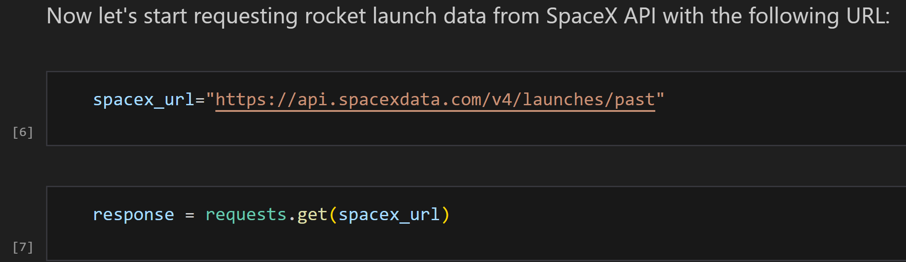
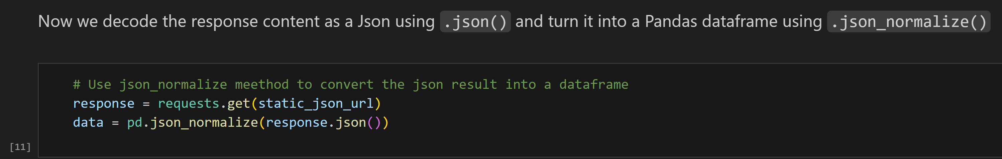
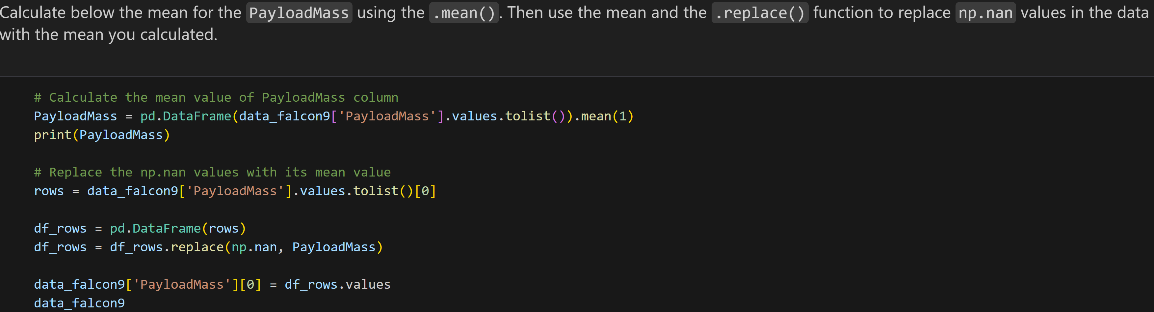
Data Collection – SpaceX API
We utilized GET requests to access the SpaceX API for data collection purposes. Subsequently, we performed data cleaning and basic data wrangling, ensuring proper formatting for further analysis.
Notebook Link
https://github.com/sharmapk0/IBM-Data-Science-SpaceX/blob/main/jupyter-labs-spacex-data-collection-api.ipynb

Slide 9
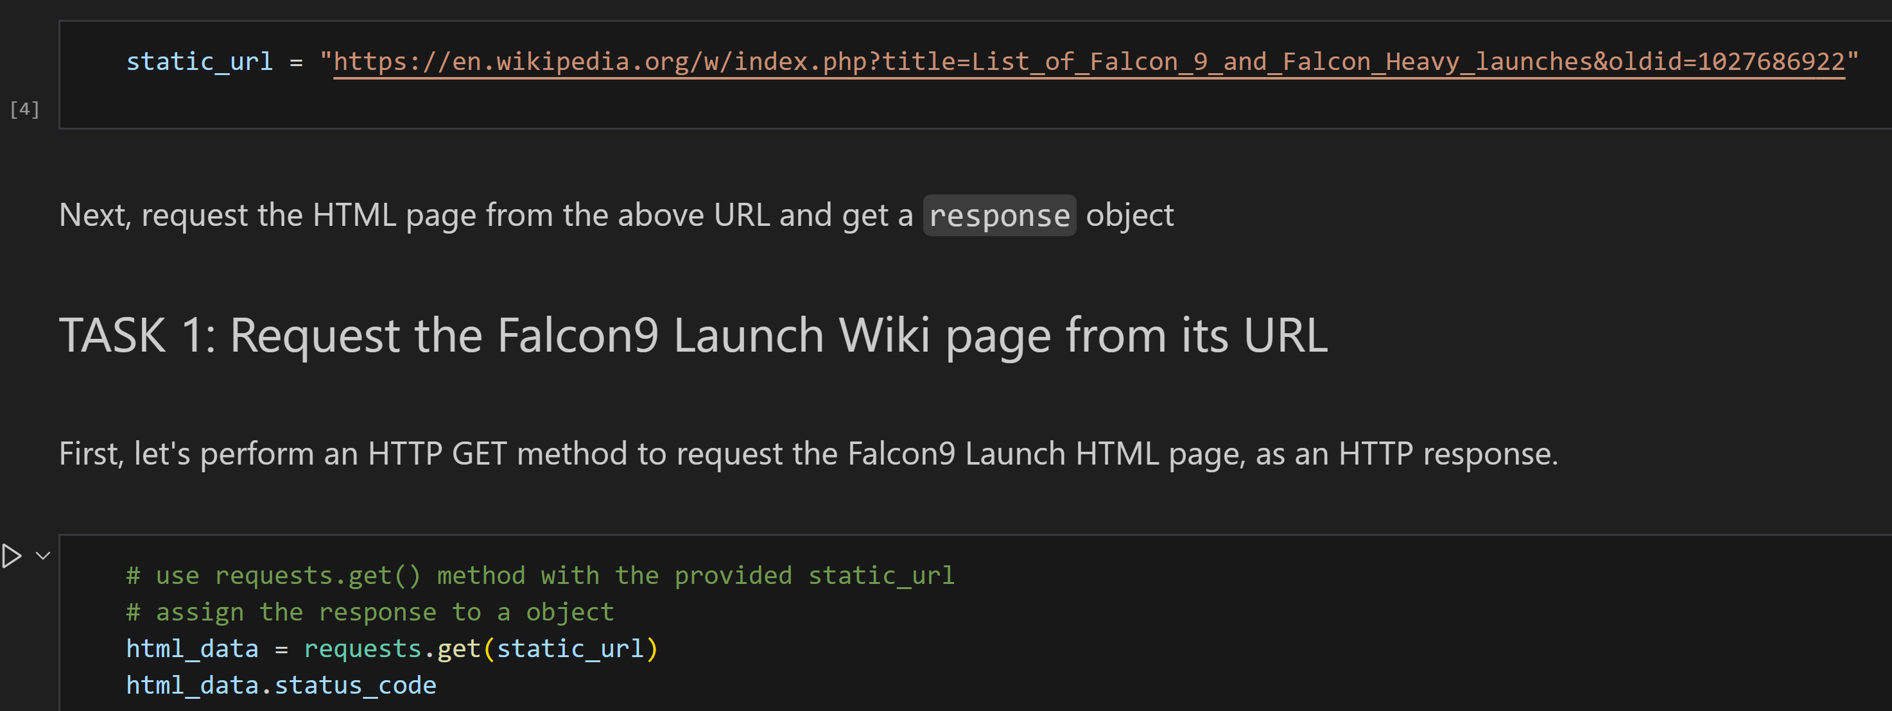
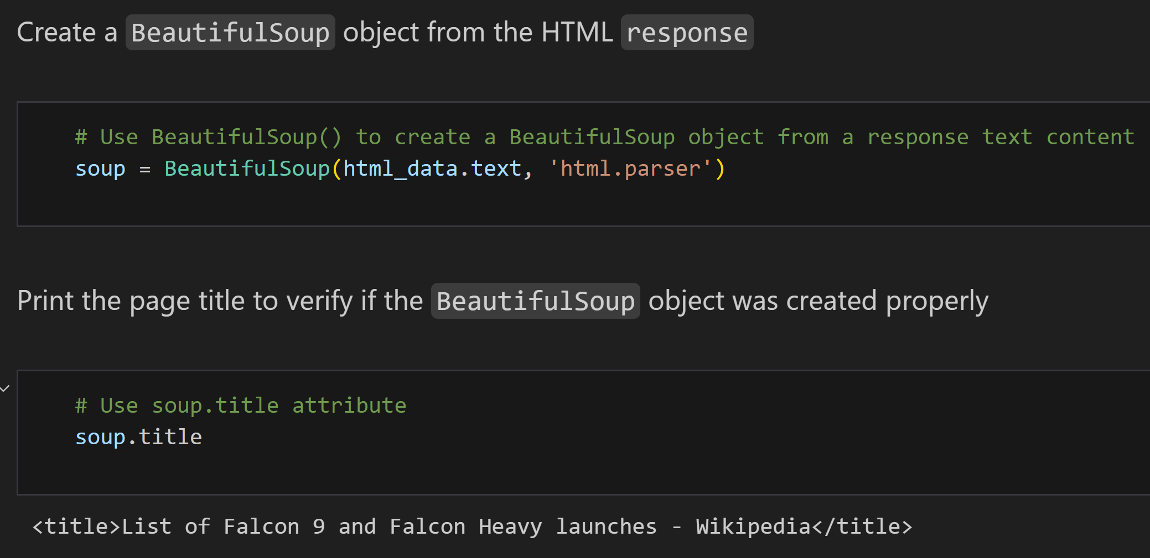
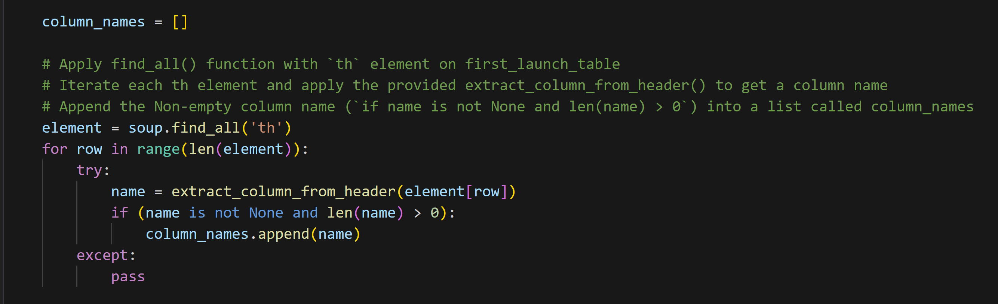
Data Collection - Scraping
We utilized web scraping techniques with BeautifulSoup to extract Falcon 9 launch records. Subsequently,
we parsed the obtained table and converted it into a pandas dataframe.
Notebook Link
https://github.com/sharmapk0/IBM-Data-Science-SpaceX/blob/main/jupyter-labs-webscraping.ipynb

Slide 10

Data Wrangling
We conducted exploratory data analysis to determine training labels.
This included counting launches at each site and analyzing orbit occurrences.
Subsequently, we created landing outcome labels from the outcome column and exported the results to CSV.
Notebook Link
https://github.com/sharmapk0/IBM-Data-Science-SpaceX/blob/main/labs-jupyter-spacex-Data%20wrangling.ipynb

Slide 11
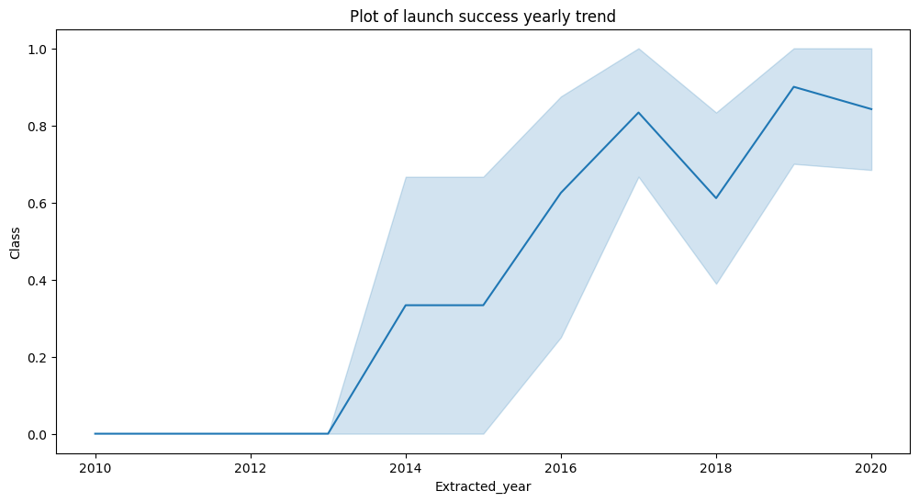
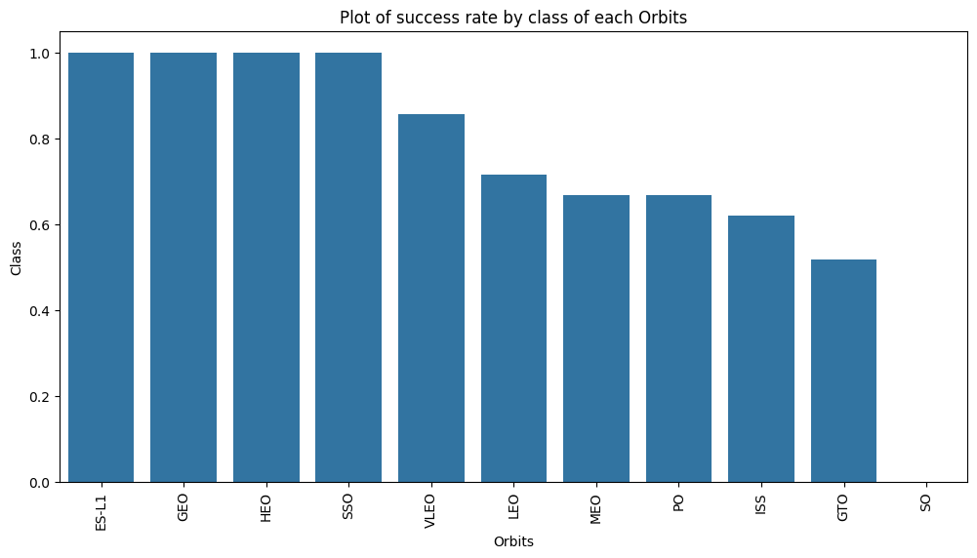
EDA with Data Visualization
We explored the data through visualizations, examining the relationships between flight number and launch site, payload and launch site, success rates of each orbit type, flight number and orbit type, and the yearly trend of launch success.
Notebook Link
https://github.com/sharmapk0/IBM-Data-Science-SpaceX/blob/main/edadataviz.ipynb

Slide 12
EDA with SQL
We imported the SpaceX dataset directly into a PostgreSQL database within our Jupyter Notebook environment. Using SQL,
we conducted exploratory data analysis (EDA) to extract valuable insights. Our queries allowed us to discover key information, such as:
Identifying the unique launch sites involved in space missions.
Calculating the total payload mass carried by boosters launched by NASA for Commercial Resupply Services (CRS) missions.
Determining the average payload mass carried by boosters of version F9 v1.1.
Counting the total number of successful and failed mission outcomes.
Extracting details of failed landing outcomes on drone ships, including the booster version and launch site names.
Notebook Link
https://github.com/sharmapk0/IBM-Data-Science-SpaceX/blob/main/jupyter-labs-eda-sql-coursera_sqllite.ipynb

Slide 13
Build an Interactive Map with Folium
We utilized Folium maps to visually represent SpaceX launch sites, integrating markers, circles, and lines to denote the success or failure of launches at each site. To facilitate analysis, we categorized launch outcomes into two classes: 0 for failure and 1 for success.
By employing color-coded marker clusters, we identified launch sites with notably high success rates. Additionally, we conducted distance calculations between launch sites and their surroundings, addressing questions such as:
Proximity to railways, highways, and coastlines.
Whether launch sites maintain a certain distance from cities.
This approach enabled us to gain insights into the geographical factors surrounding launch sites and their impact on mission outcomes.
Notebook Link
https://github.com/sharmapk0/IBM-Data-Science-SpaceX/blob/main/lab_jupyter_launch_site_location.ipynb

Slide 14
Build a Dashboard with Plotly Dash
We created an interactive dashboard using Plotly Dash, enhancing data visualization and analysis capabilities. Within the dashboard:
We generated pie charts displaying the total launches from specific sites, providing a comprehensive overview of launch distribution.
We utilized scatter plots to illustrate the relationship between launch outcomes and payload mass (in kilograms) across different booster versions, offering insights into performance variations.
This integration of Plotly Dash facilitated dynamic exploration of SpaceX mission data, enabling users to interactively explore launch site statistics and analyze correlations between launch outcomes and payload masses across various booster versions.
Notebook Link
https://github.com/sharmapk0/IBM-Data-Science-SpaceX/blob/main/spacex_dash_app.py

Slide 15
Predictive Analysis (Classification)
We loaded and preprocessed the data with NumPy and pandas, then split it into training and testing sets. By employing GridSearchCV,
we fine-tuned hyperparameters across various machine learning models to maximize accuracy.
Through iterative feature engineering and algorithm tuning, we optimized model performance,
ultimately identifying the best-performing classification model based on accuracy.
Notebook Link
https://github.com/sharmapk0/IBM-Data-Science-SpaceX/blob/main/SpaceX_Machine%20Learning%20Prediction_Part_5.ipynb

Slide 16
Results
Exploratory data analysis results
Interactive analytics demo in screenshots
Predictive analysis results

Slide 17

Section 2

Slide 18
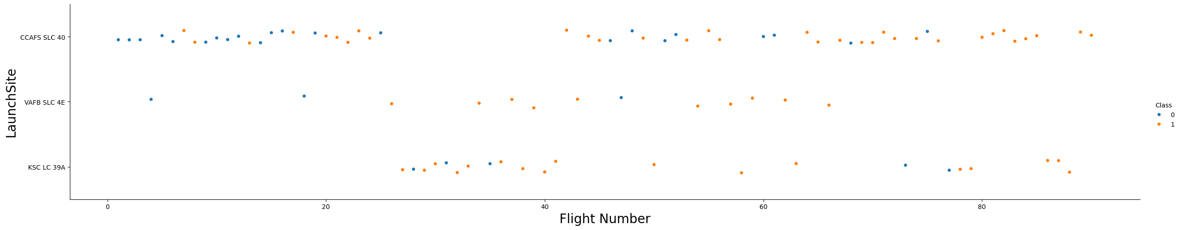
Flight Number vs. Launch Site
From the plot, we found that the larger the flight amount at a launch site, the greater the success rate at a launch site.

Slide 19
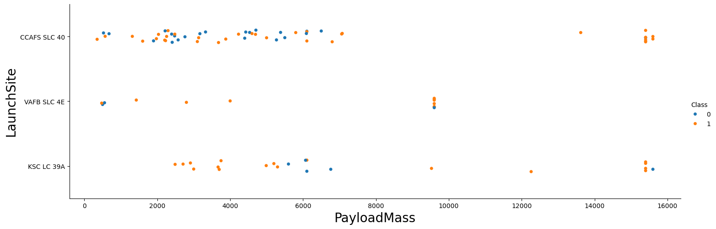
Payload vs. Launch Site
The greater the payload mass for launch site CCAFS SLC 40 the higher the success rate for the rocket.

Slide 20
Success Rate vs. Orbit Type
From the plot, we can see that ES-L1, GEO, HEO, SSO, VLEO had the most success rate.

Slide 21
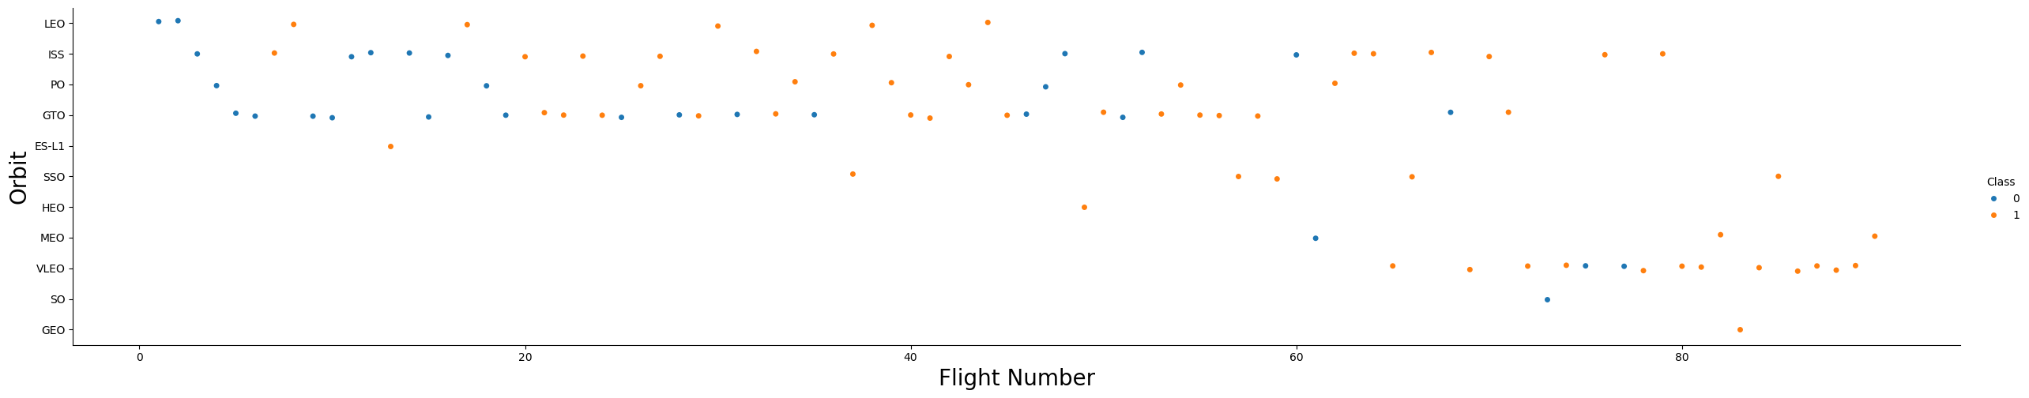
Flight Number vs. Orbit Type
The plot depicts Flight Number plotted against Orbit type. It reveals a correlation between the number of flights and success in Low Earth Orbit (LEO), whereas no such relationship is evident in Geostationary Transfer Orbit (GTO).

Slide 22
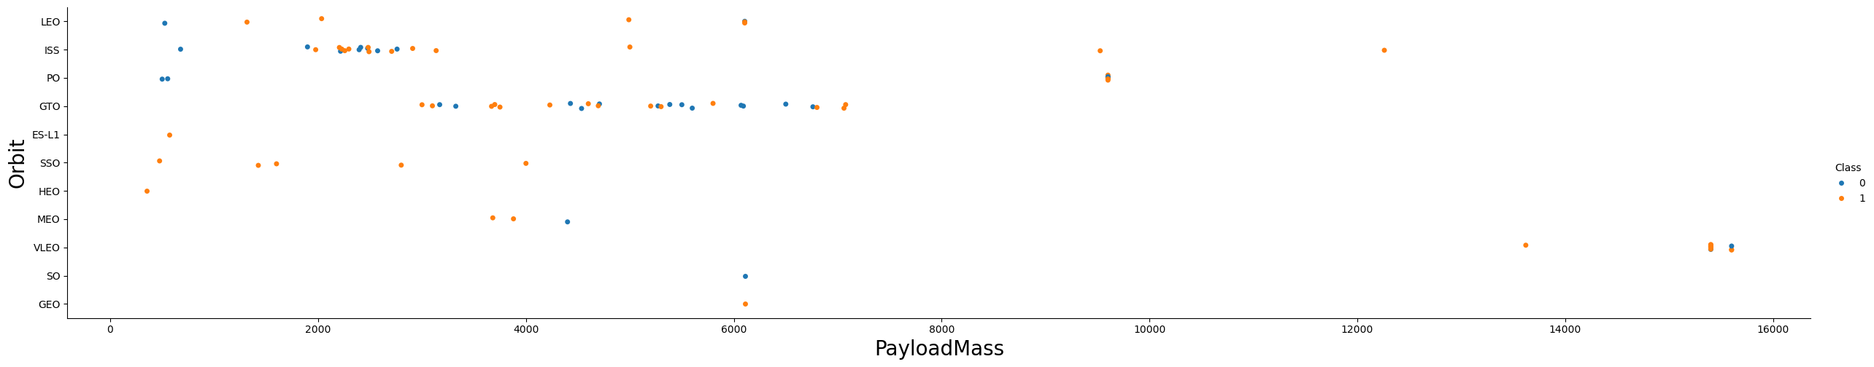
Payload vs. Orbit Type
We can observe that with heavy payloads, the successful landing are more for PO, LEO and ISS orbits.

Slide 23
Launch Success Yearly Trend
From the plot, we can observe that success rate since 2013 kept on increasing till 2020.

Slide 24
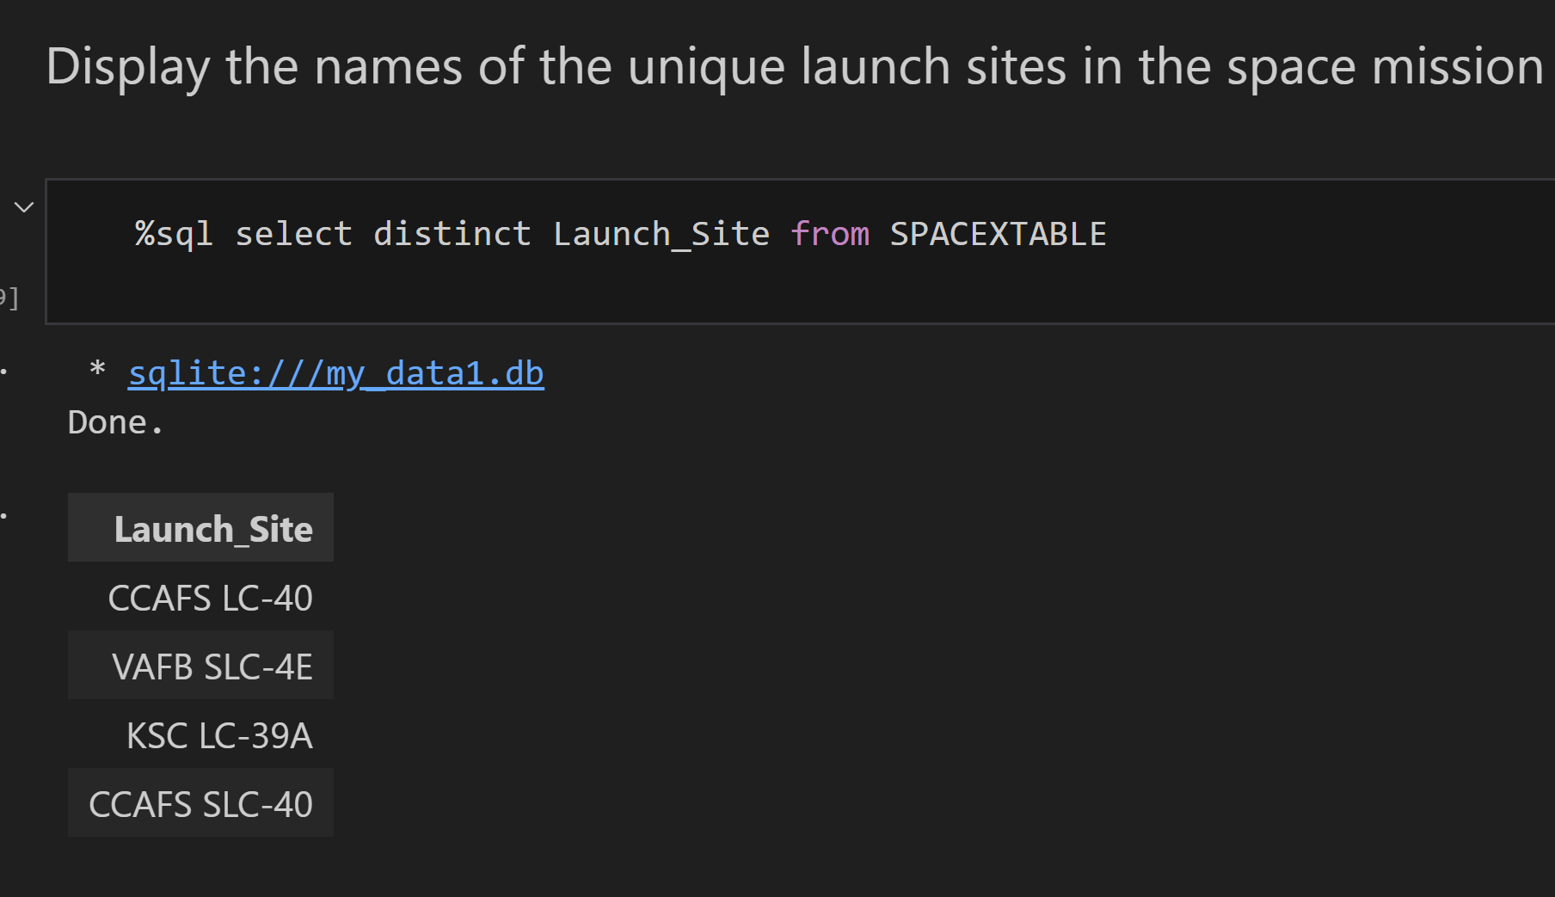
All Launch Site Names
We utilized the DISTINCT keyword to display only unique launch sites extracted from the SpaceX dataset.

Slide 25
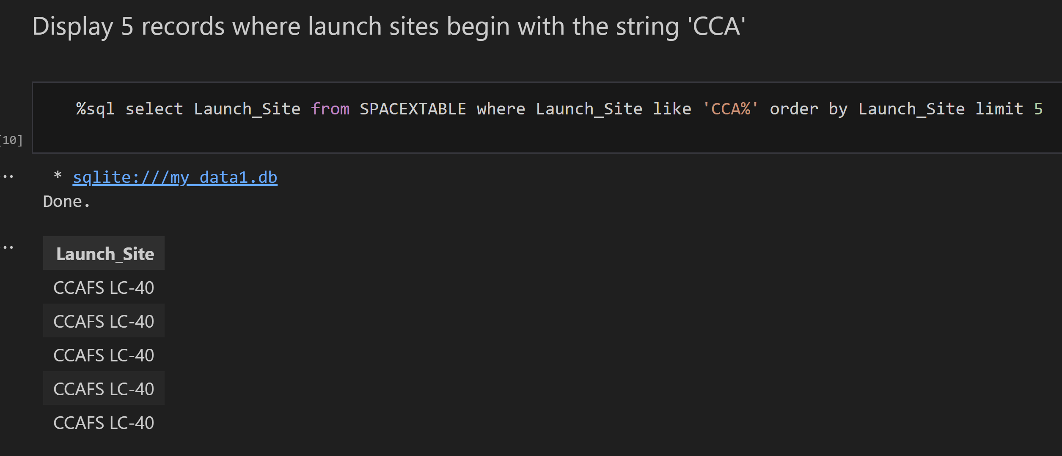
Launch Site Names Begin with 'CCA'
We used the query above to display 5 records where launch sites begin with CCA

Slide 26
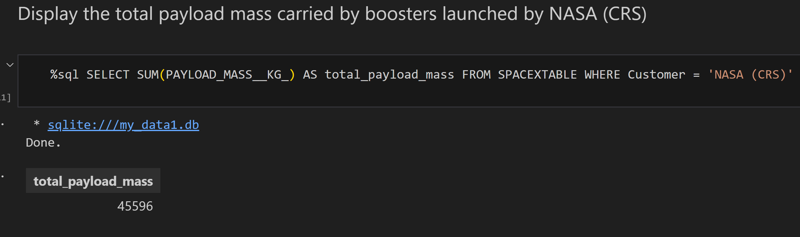
Total Payload Mass
We calculated the total payload carried by boosters from NASA as 45596 using the query below

Slide 27
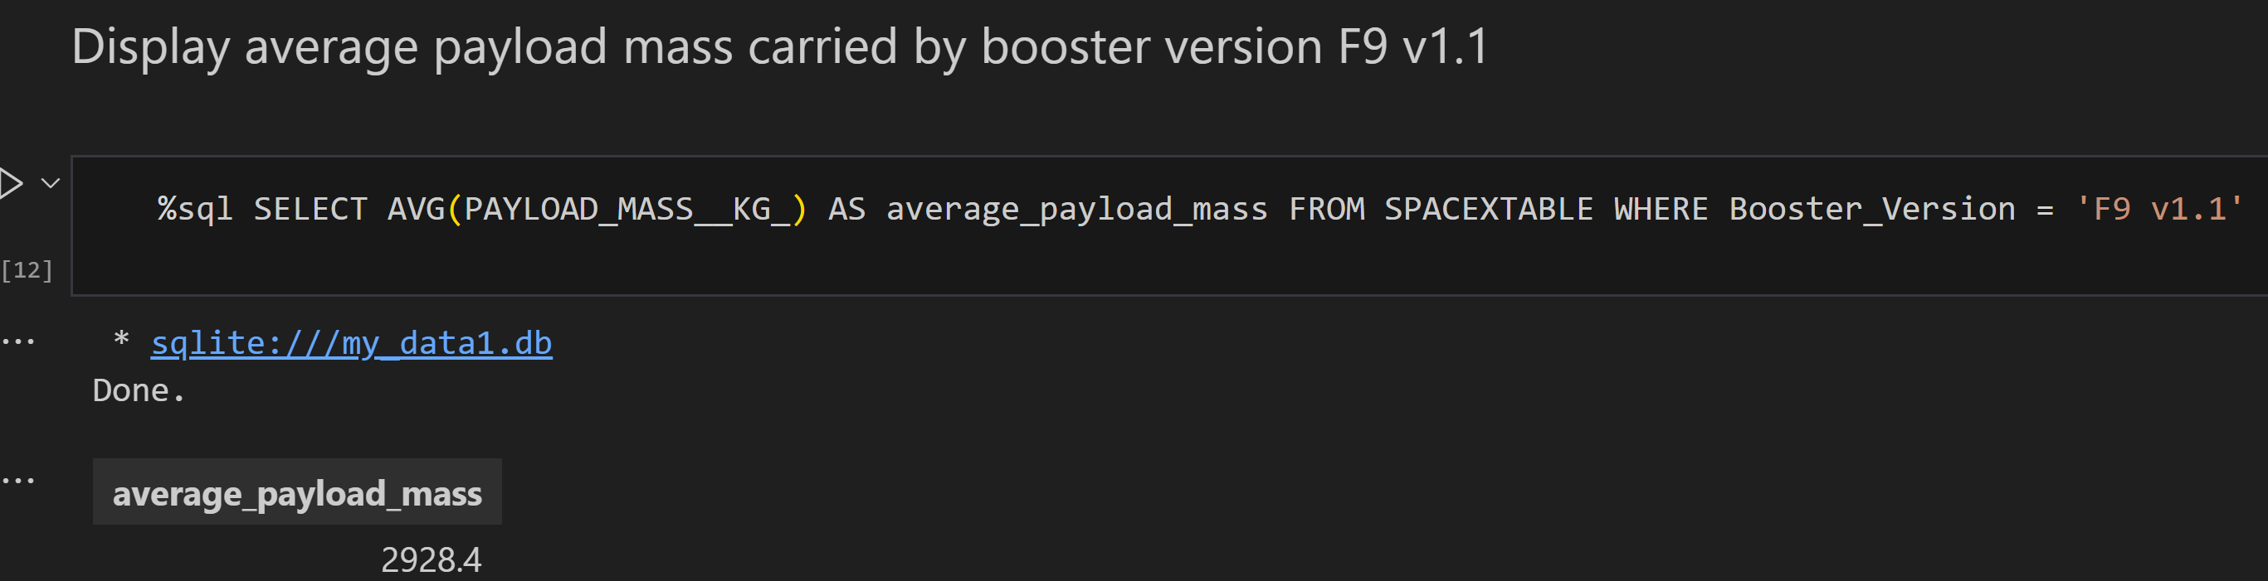
Average Payload Mass by F9 v1.1
We calculated the average payload mass carried by booster version F9 v1.1 as 2928.4

Slide 28
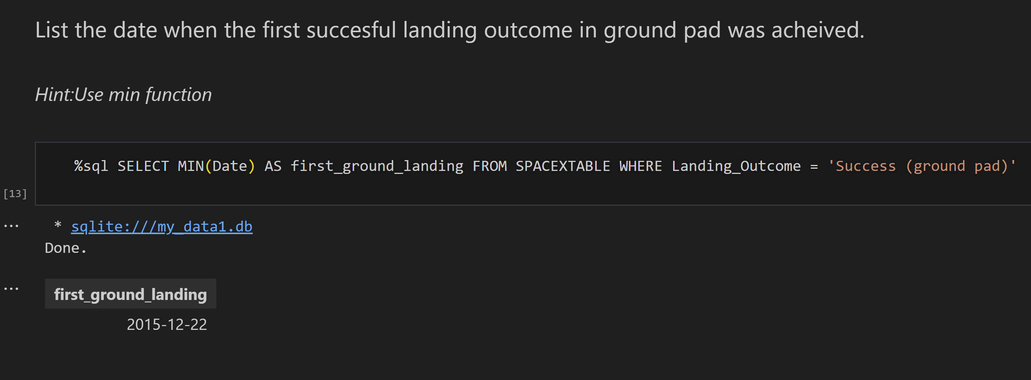
First Successful Ground Landing Date
We observed that the dates of the first successful landing outcome on ground pad was 22nd December 2015

Slide 29

Successful Drone Ship Landing with Payload between 4000 and 6000
We used the WHERE clause to filter for boosters which have successfully landed on drone ship and applied the AND condition to determine successful landing with payload mass greater than 4000 but less than 6000

Slide 30

Total Number of Successful and Failure Mission Outcomes
We used wildcard like ‘%’ to filter for WHERE MissionOutcome was a success or a failure.

Slide 31

Boosters Carried Maximum Payload
We determined the booster that have carried the maximum payload using a subquery in the WHERE clause and the MAX() function.

Slide 32

2015 Launch Records
We used a combinations of the WHERE clause, LIKE, AND, and BETWEEN conditions to filter for failed landing outcomes in drone ship, their booster versions, and launch site names for year 2015

Slide 33

Rank Landing Outcomes Between 2010-06-04 and 2017-03-20
We selected Landing outcomes and the COUNT of landing outcomes from the data and used the WHERE clause to filter for landing outcomes BETWEEN 2010-06-04 to 2010-03-20.
We applied the GROUP BY clause to group the landing outcomes and the ORDER BY clause to order the grouped landing outcome in descending order.

Slide 34

Section 3

Slide 35

All launch sites global map markers

Slide 36

Markers showing launch sites with color labels
Replace <Folium map screenshot 2> title with an appropriate title
Explore the folium map and make a proper screenshot to show the color-labeled launch outcomes on the map
Explain the important elements and findings on the screenshot

Slide 37

Launch Site distance to landmarks
Replace <Folium map screenshot 3> title with an appropriate title
Explore the generated folium map and show the screenshot of a selected launch site to its proximities such as railway, highway, coastline, with distance calculated and displayed
Explain the important elements and findings on the screenshot

Slide 38

Section 4

Slide 39

Pie chart showing the success percentage achieved by each launch site
Replace <Dashboard screenshot 1> title with an appropriate title
Show the screenshot of launch success count for all sites, in a piechart
Explain the important elements and findings on the screenshot

Slide 40

Pie chart showing the Launch site with the highest launch success ratio

Slide 41

Scatter plot of Payload vs Launch Outcome for all sites, with different payload selected in the range slider

Slide 42

Section 5

Slide 43
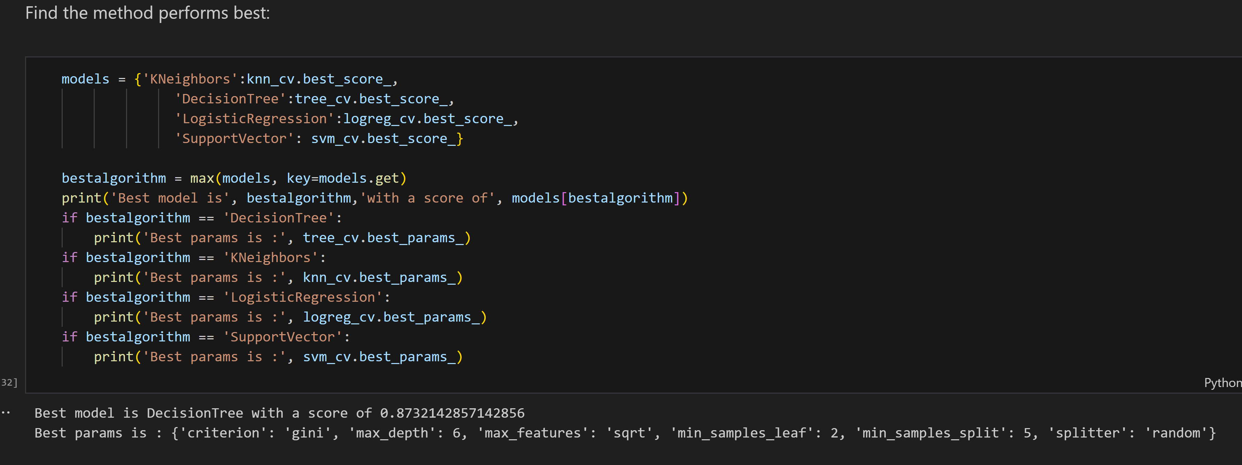
Classification Accuracy
The decision tree classifier is the model with the highest classification accuracy

Slide 44

Confusion Matrix
The confusion matrix for the decision tree classifier shows that the classifier can distinguish between the different classes. The major problem is the false positives. unsuccessful landing marked as successful landing by the classifier.

Slide 45
Conclusions
From our analysis, it's evident that:
There's a positive correlation between the number of flights at a launch site and its success rate.
Launch success rates have been on the rise since 2013 until 2020.
Orbits such as ES-L1, GEO, HEO, SSO, and VLEO exhibited notably high success rates.
KSC LC-39A emerged as the launch site with the highest number of successful launches.
Among the tested machine learning algorithms, the Decision Tree Classifier demonstrated superior performance for this task.

Slide 46


